Slide 1

Lecture 4
Nick Rugai PhD

Slide 2
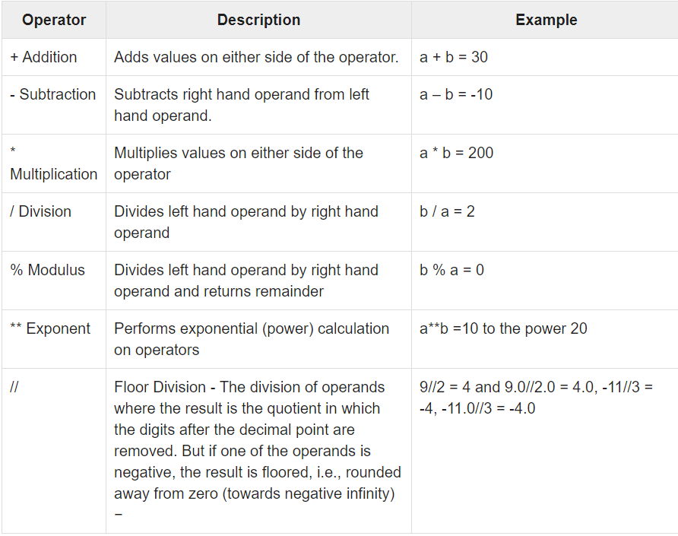
Operations

Slide 3
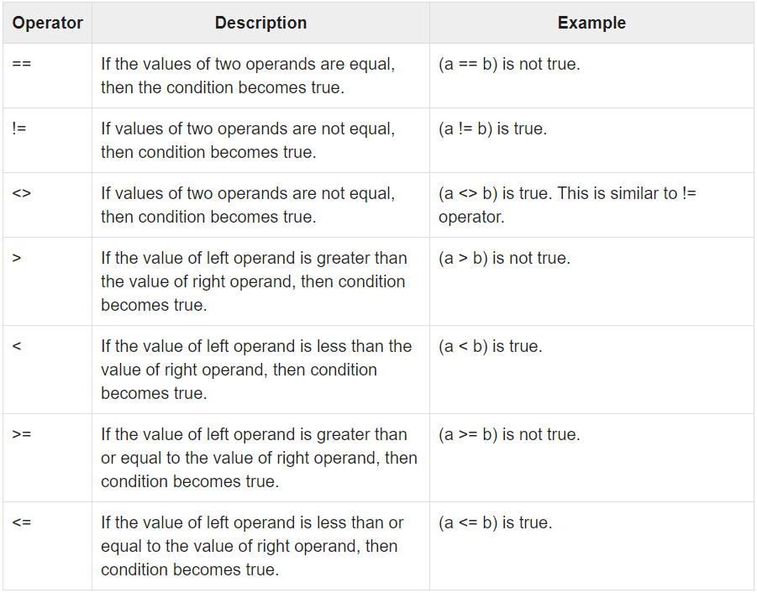
Operations

Slide 4
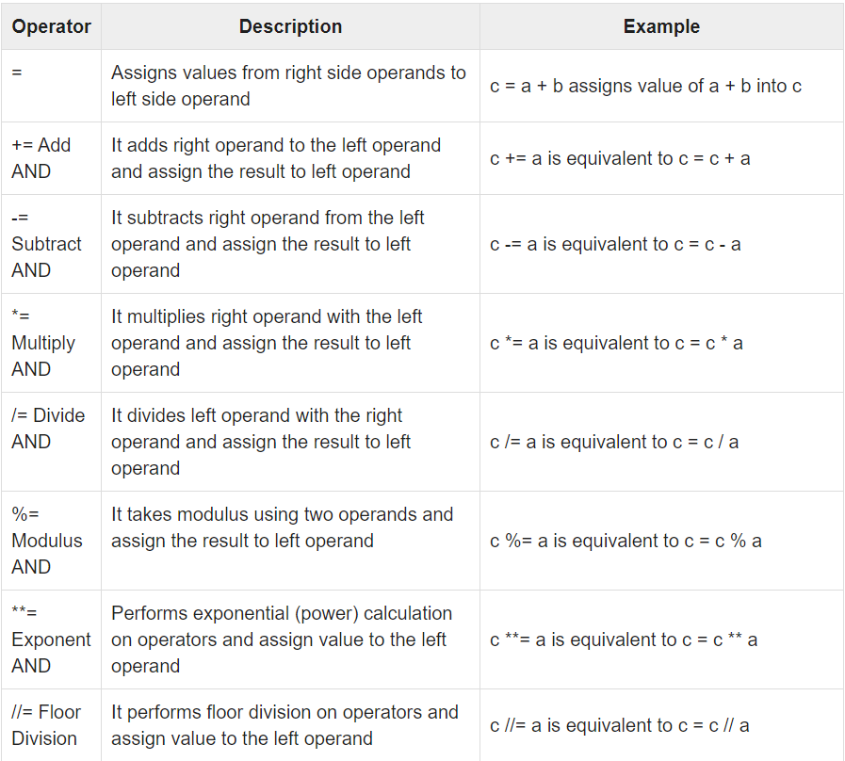
Operations

Slide 5
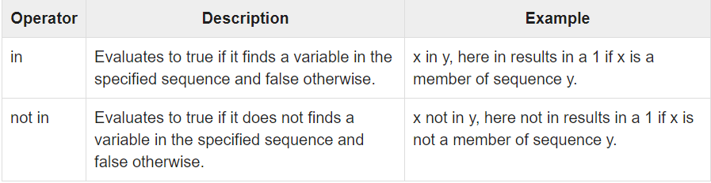
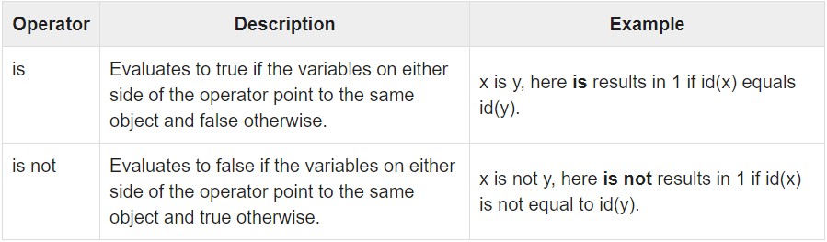
Operations

Slide 6
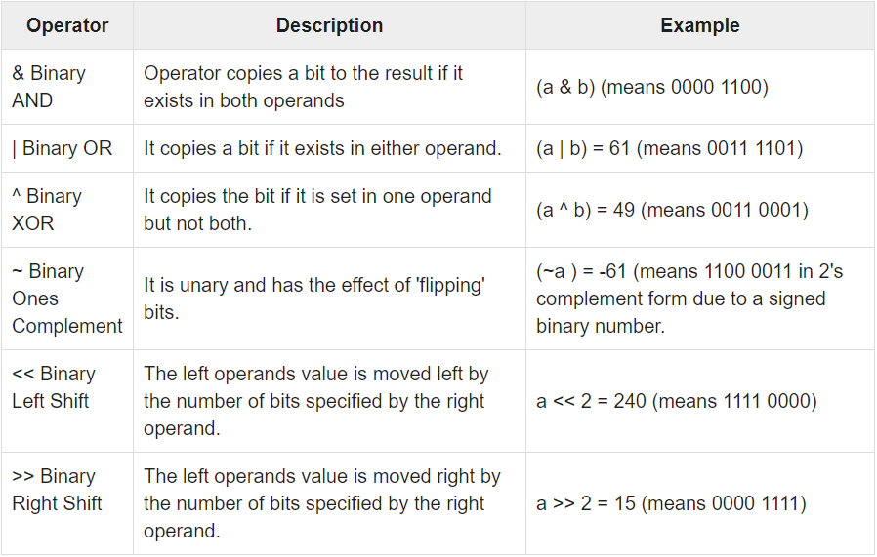
Operations

Slide 7
Operations
>>> oct(x) returns the value in octal (base 8).
>>> hex(x) returns the value in hexadecimal (base 16).
Import math, math.pi, math.e, abs(x), math.sin(x), pow(x,y), round(x), int(float x)…

Slide 8
Strings
>>> s0 = Hello #Statement
>>> s0+s1 #Concatenate
>>> s0*3 #Repeat
>>> s0[i] #Index
>>> s0[i:j] #Slice
>>> len(s0) #Length
>>> s0.find(‘l’) #Method call
>>> s0.replace(‘he’, ‘xx’) #Method call

Slide 9
Strings
>>> “42” + 2
>>> int(“42) +1
>>> ‘spam’ + str(42)
>>> text = ‘1.2345’
>>> float(text)
>>> s5= ‘flat’
>>> ‘The world is %s’ %s5 # Overload
>>> ‘That is one %s bird’ %(‘dead’)
>>> “%d %s %d” % (1, ‘dead’, 2)

Slide 10
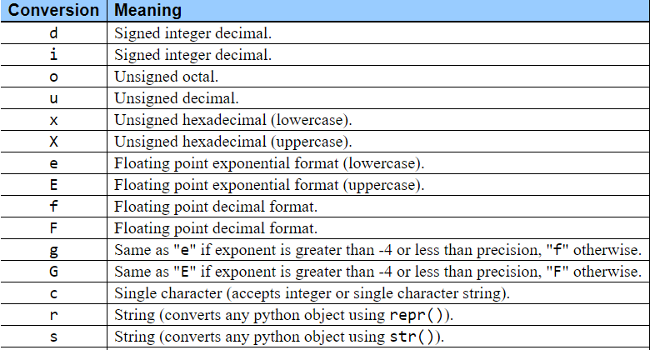
Strings

Slide 11
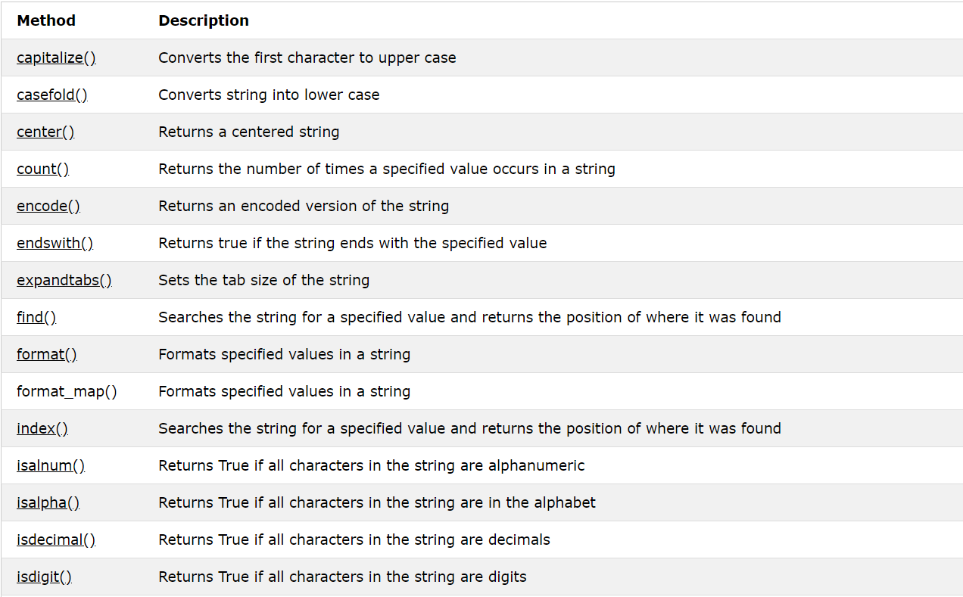
Strings

Slide 12
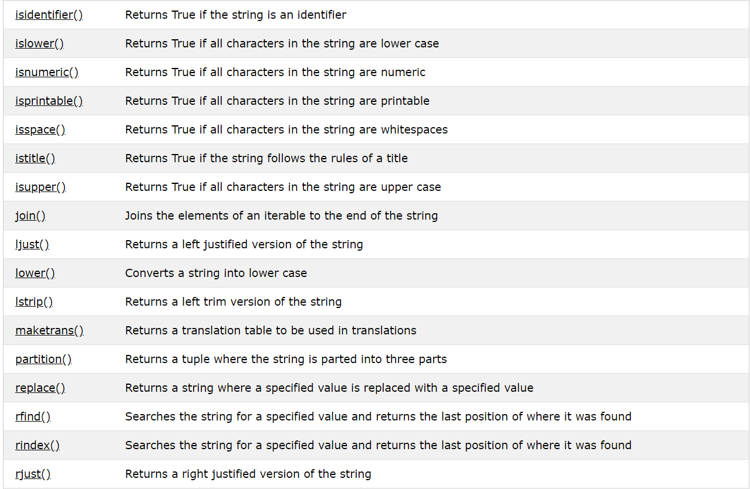
Strings

Slide 13
Strings
>>> s=’a+b+c’
>>> x=s.replace(‘+’, ‘spam’)

